Slide 1
Instant Insanity Puzzle: QAOA Approach
By: Sisir Pynda & Martin Carignan

Slide 2
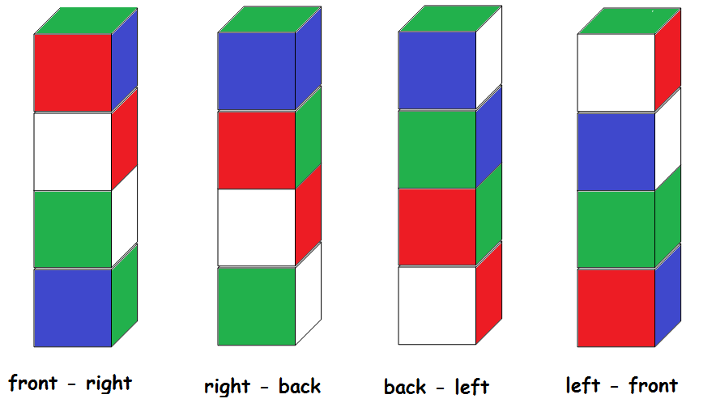
What is the Instant Insanity Puzzle?
Instant Insanity is a graphing problem puzzle.
You are given four cubes that have different colors on each side, however, there are up to four unique colors in this entire puzzle.
The objective of this game is to stack the cubes in a way that each cube on the face of a stack does not have a repeating color.
3D Visualization: https://instantinsanity.z20.web.core.windows.net/

Slide 3
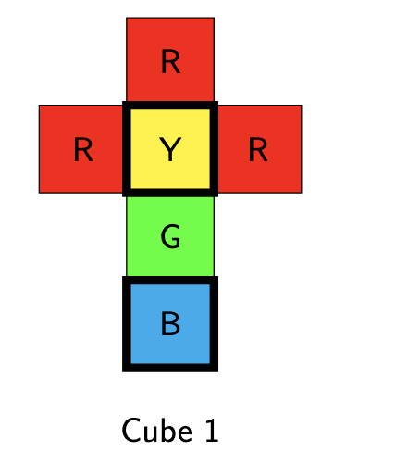
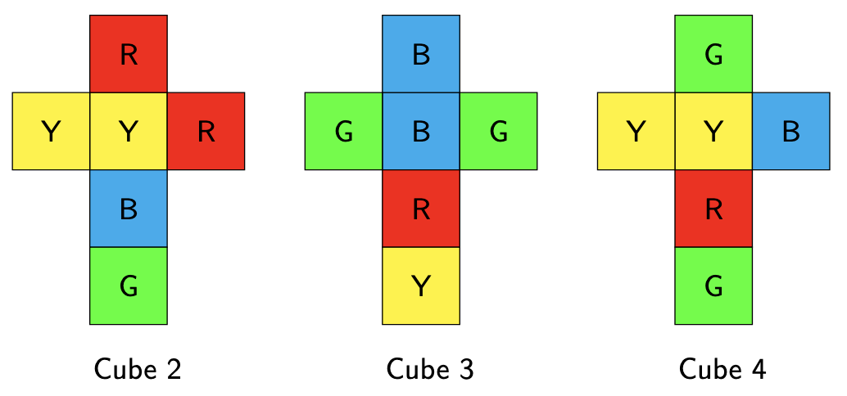
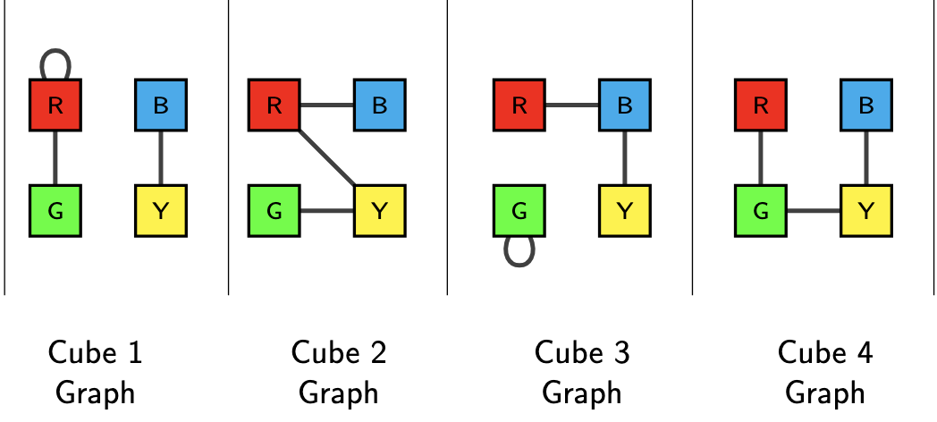
Graphing Approach
Draw a graph for each cube, connecting opposite faces

Slide 4
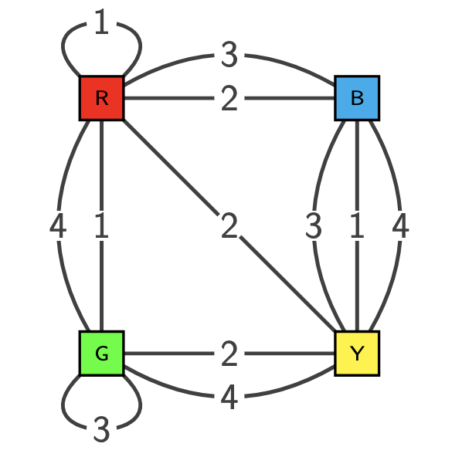
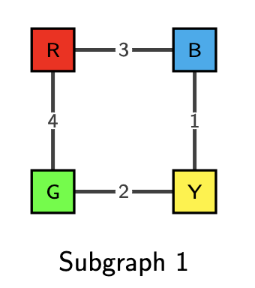
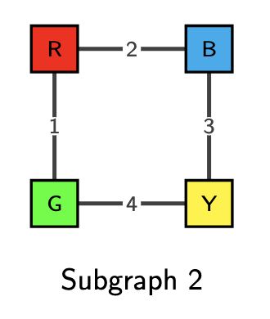
Graphing Approach (cont.)
Steps:
Put all 4 graphs from Step 1 into a single graph
Find 2 subgraphs using specific instructions:
  The 2 subgraphs have no edges in common
  Each subgraph contains exactly one edge from each cube
  Each node only has 2 edges connected to it
Front-Back
Left-Right
Notes:
One subgraph corresponds to the colors that will be on the left and right faces, the other subgraph will correspond to the colors that will be on the front and back faces of the stack.

Slide 5
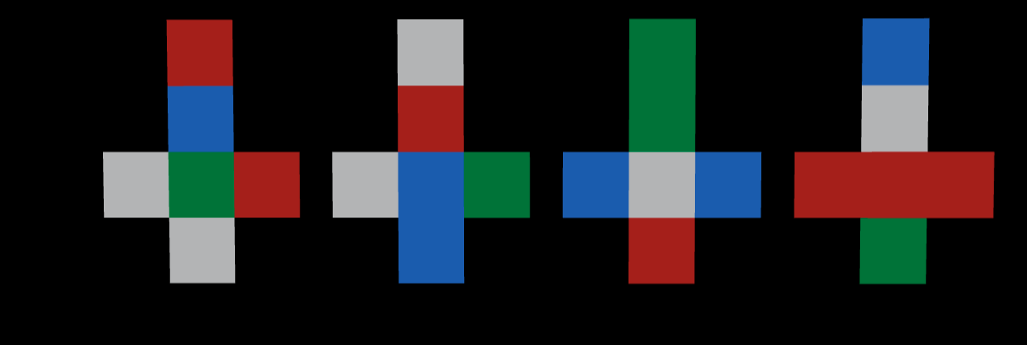
The Problem Cube
Interactive Visualization

Slide 6
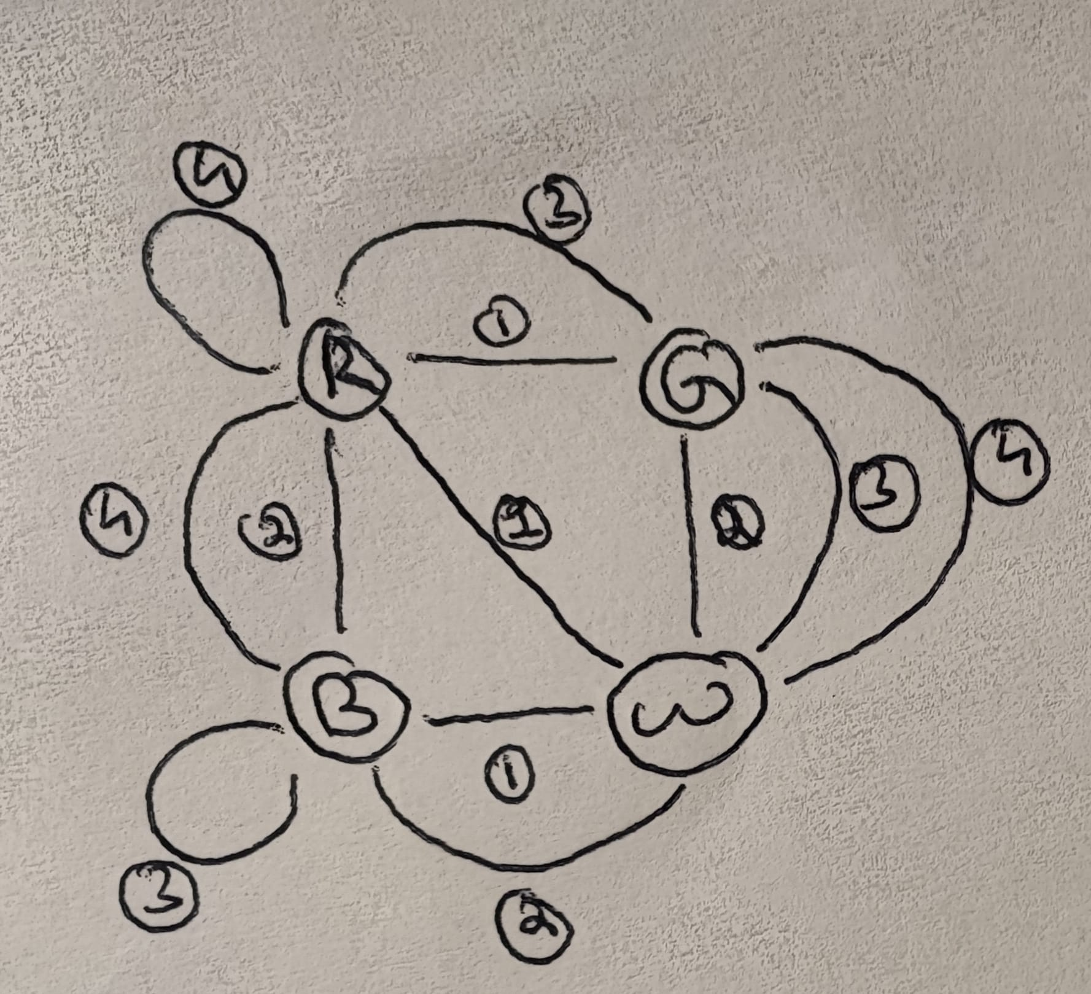
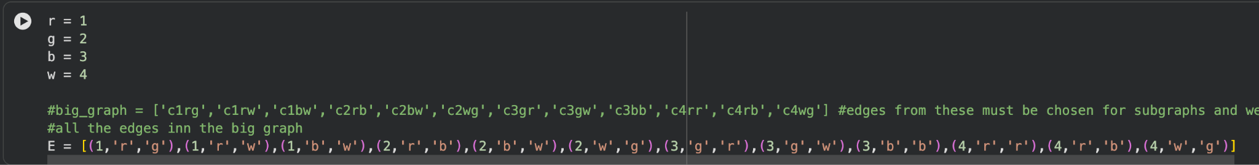
Modeling the Problem
This Problem was solved using graph theory.
Nodes: Colours white, green, reg,blue
Edges: Cube 1,2,3,4
4 cube system

Slide 7
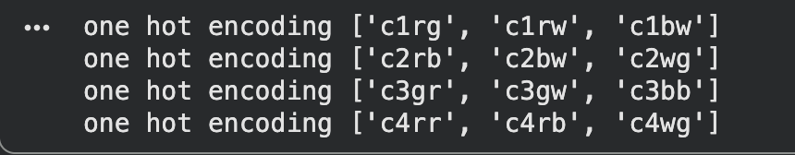
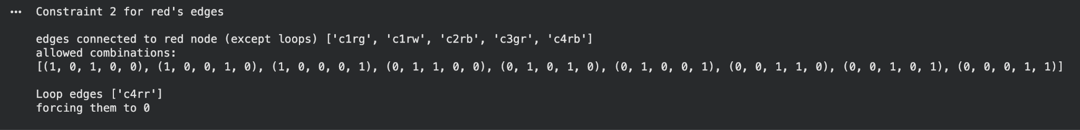
Classical Approach
To solve the problem we needed to extract two subgraphs from the main graph (These subgraphs represent the Front-back and Left-Right side relationships of the solution )
Embedded Rules :
Rule 1: Degree of each node is 2 (one for each side)
Rule 2: All 4 cubes have an edge in each subgraph
Our planned approach is to use QAOA to find the correct cube combinations that solve the puzzle.
Notes:
In the first image we are setting up for the first constraint of choosing one edge from each cube. The second image shows the last two constraints of two degrees per node and from a different cube.
NOTE: we had to add another constraint not part of the original classical graph solution, where we set any self looping edges to weight of zero. We do this because for some reason it was considering these edges in the incorrect situations and we were using too many qubits

Slide 8
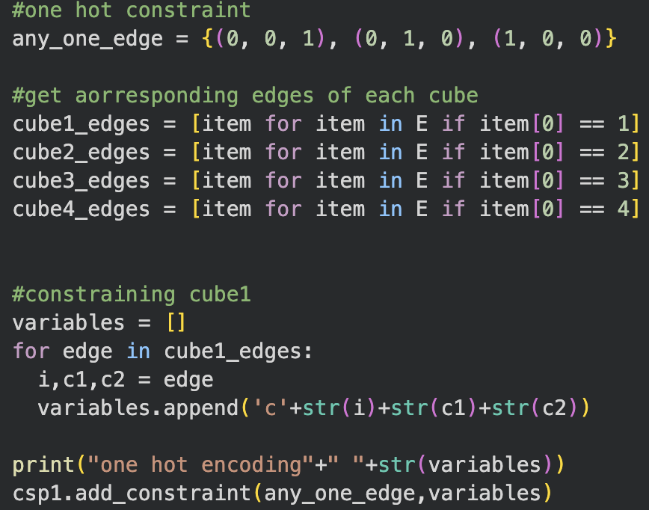
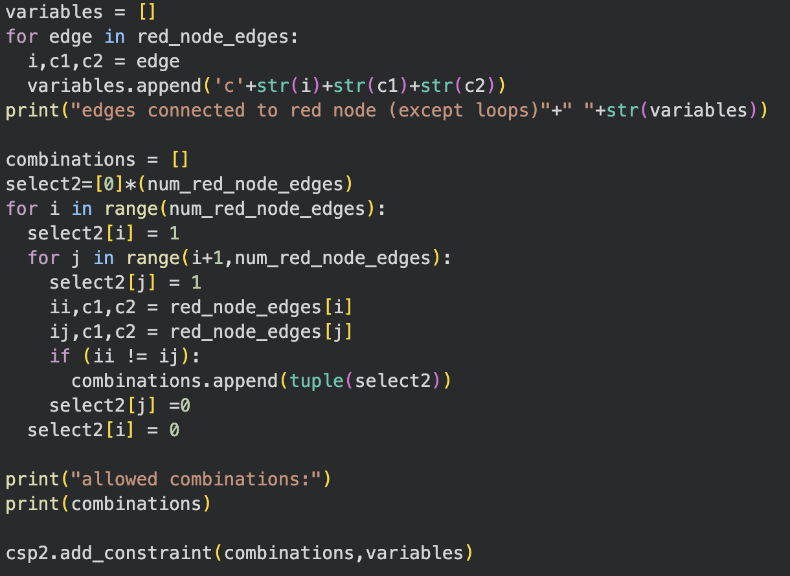
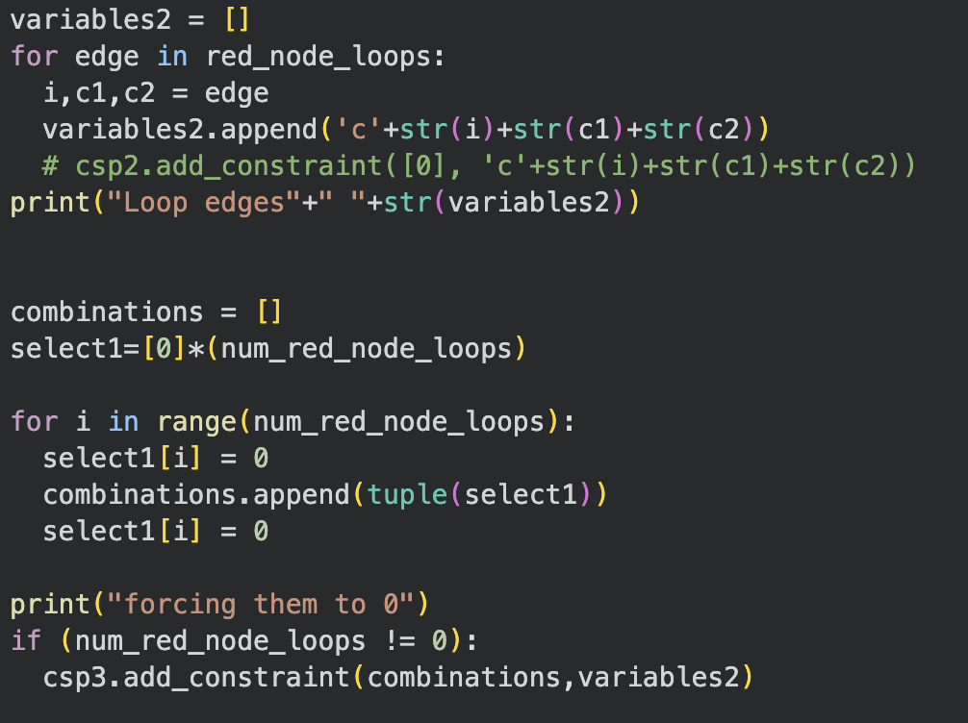
Classical Approach (cont.)
D-Wave has the dwavebinarycsp library we can use to input our constraints problem in a classical form to translate into a QUBO.
We turn the problem into a binary quadratic model, which was created by applying the constraints we fed the binary csp.
Notes:
Through the binarycsp library we will be able to obtain our QUBO and neal will show us the energies for our best configurations to solve the problem.
(Explain the images as well)
Here we are making the graph with all the cubes edges combined in one graph, soon after this we add the constraint for the algorithm to choose one edge for the subgraph step.

Slide 9
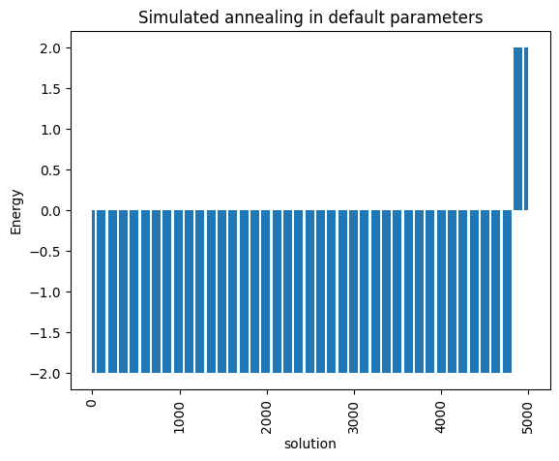
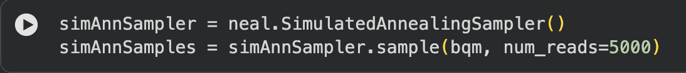
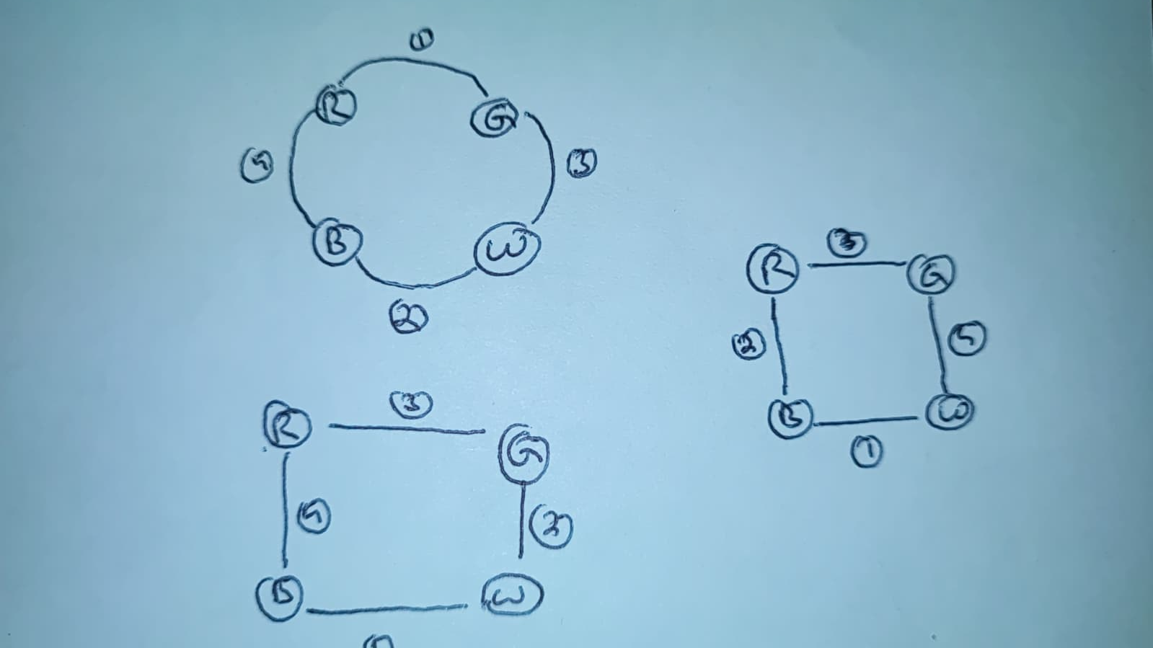
D-Wave Results
After using simulated annealing we see the number of solutions possible.
Notes:
The binary quadratic model is made up of quadratic penalty functions which can be represented as the QUBO.

Slide 10
Formulation - Extracted QUBO equation
We get the QUBO from bqm:
  8.0*xc1rw*xc1rg + 4.0*xc1bw*xc1rg + 8.0*xc1bw*xc1rw + 4.0*xc2rb*xc1bw + 4.0*xc2bw*xc1rw + 2.0*xc2bw*xc1bw + 8.0*xc2bw*xc2rb + 4.0*xc2wg*xc1rg + 4.0*xc2wg*xc1bw + 4.0*xc2wg*xc2rb + 8.0*xc2wg*xc2bw + 4.0*xc3gr*xc1rg + 4.0*xc3gr*xc2rb + 4.0*xc3gr*xc2wg + 2.0*xc3gw*xc1rg + 4.0*xc3gw*xc1rw + 4.0*xc3gw*xc1bw + 4.0*xc3gw*xc2bw + 8.0*xc3gw*xc2wg + 8.0*xc3gw*xc3gr + 4.0*xc3bb*xc3gr + 4.0*xc3bb*xc3gw + 4.0*xc4rb*xc1bw + 8.0*xc4rb*xc2rb + 4.0*xc4rb*xc2bw + 4.0*xc4rb*xc3gr + 4.0*xc4rb*xc4rr + 4.0*xc4wg*xc1rg + 4.0*xc4wg*xc1rw + 4.0*xc4wg*xc1bw + 4.0*xc4wg*xc2bw + 8.0*xc4wg*xc2wg + 4.0*xc4wg*xc3gr + 8.0*xc4wg*xc3gw + 4.0*xc4wg*xc4rr + 4.0*xc4wg*xc4rb + 4.0*xaux0*xc1rg + 4.0*xaux0*xc1rw + -4.0*xaux0*xc2rb + -4.0*xaux0*xc3gr + -4.0*xaux0*xc4rb + 2.0*xaux1*xc1rg + 2.0*xaux1*xc3gr + -4.0*xaux1*xc3gw + 2.0*xaux2*xc1bw + -4.0*xaux2*xc2bw + -4.0*xaux2*xc4rb + 4.0*xaux3*xc1rw + -4.0*xaux3*xc1bw + 4.0*xaux3*xc2bw + -4.0*xaux3*xc2wg + -10.0*xc1rg + -10.0*xc1rw + -10.0*xc1bw + -10.0*xc2rb + -12.0*xc2bw + -10.0*xc2wg + -10.0*xc3gr + -12.0*xc3gw + -10.0*xc4rb + -14.0*xc4wg + 4.0*xaux0 + 2.0*xaux1 + 6.0*xaux2 + 34.0
Given our QUBO, now we can use it as our cost Hamiltonian by converting it to a SparsePauliOp with the specific weights we were given from the binary csp process.
Notes:
After this step we follow the regular QAOA process of feeding our SparsePauliOp to our self made QAOA function.

Slide 11
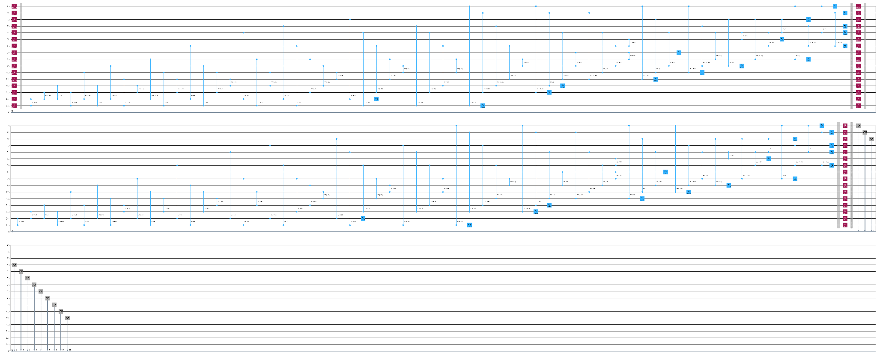
QAOA Quantum Circuit
QAOA Ansatz (gamma)
Mixer(beta)
Hadamart
Measurements

Slide 12
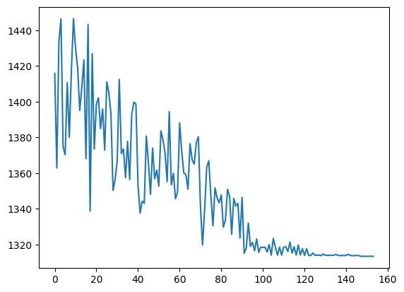
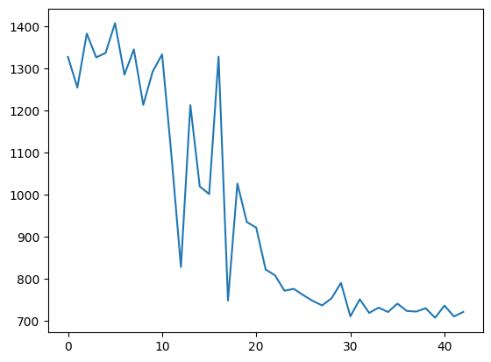
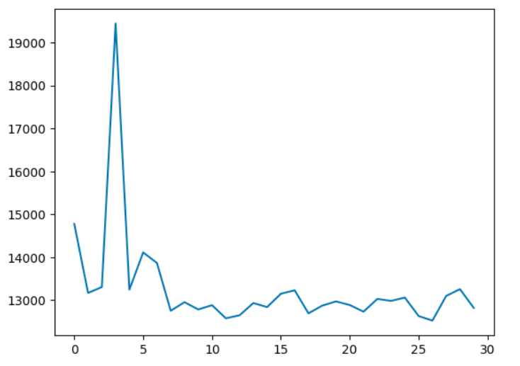
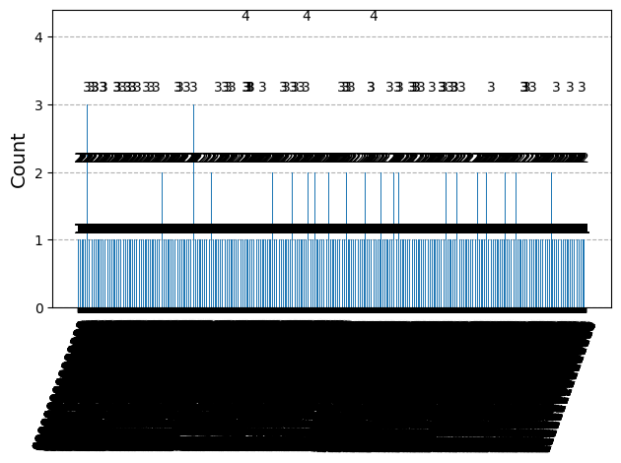
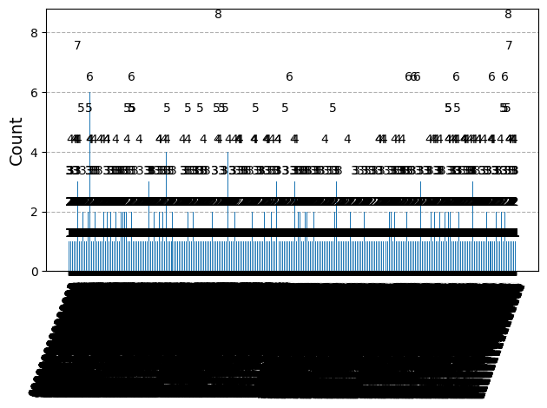
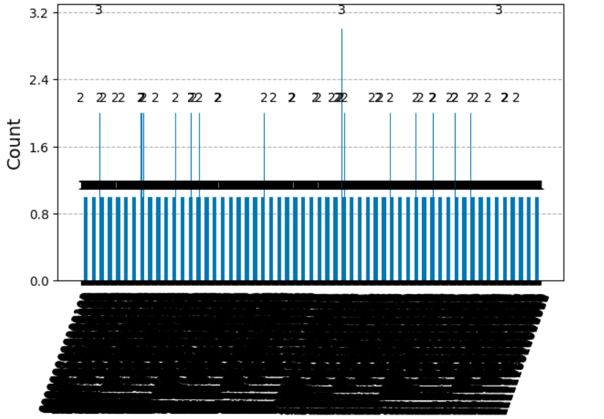
Results
Nelder-Mead
With damped jumps and bounds
Bound COBYLA
Default COBYLA on a QPU (aws_sv1)

Slide 13
None of them are perfect
Nelder - very localized
COBYLA - spread out
Analysing more probable wrong outputs suggested that some penalties were just not enough and some were outweighing others.
Example: if the system accepted one rule-violation to persist the other violations could be easily taken care of
Also P was needed to be kept small and bounds needed to be made to not let search space explode

Slide 14
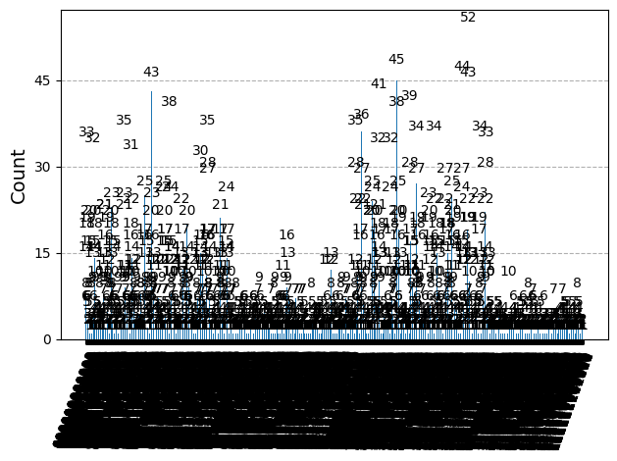
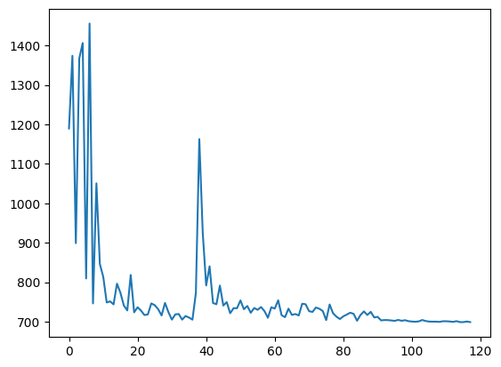
Best Approach so far - Hybrid + Tailored Energy-Cost function
# COBYLA goes haywire and tries to find everything everywhere so get a ballpark of solutions there the use NELDER to hone in

Slide 15
Modified Cost Function
def compute_expectation(counts):
total = 0
for bitstring, count in counts.items():
obj = 0
sample_values_as_ints = [int(bit) for bit in bitstring]
sample = dict(zip(bqm.variables, sample_values_as_ints))
total += bqm.energy(sample)
all_total_E.append(total)
return total
def compute_expectation(counts):
total = 0
total_shots = sum(counts.values())
for bitstring, count in counts.items():
obj = 0
sample_values_as_ints = [int(bit) for bit in bitstring]
sample = dict(zip(bqm.variables, sample_values_as_ints))
sample['aux0'] = 1
sample['aux1'] = 0
sample['aux2'] =1
sample['aux3'] = 1
for i, constraint in enumerate(csp1.constraints):
passed = constraint.check(sample)
if (not passed):
total += 30*bqm_rule1.energy(sample)
for i, constraint in enumerate(csp2.constraints)
passed = constraint.check(sample)
if (not passed):
total += 13*bqm_rule2.energy(sample)
for i, constraint in enumerate(csp3.constraints):
passed = constraint.check(sample)
if (not passed):
total += 25*bqm_rule3.energy(sample)
all_total_E.append(total/total_shots)
return total/total_shots
Before
After

Slide 16
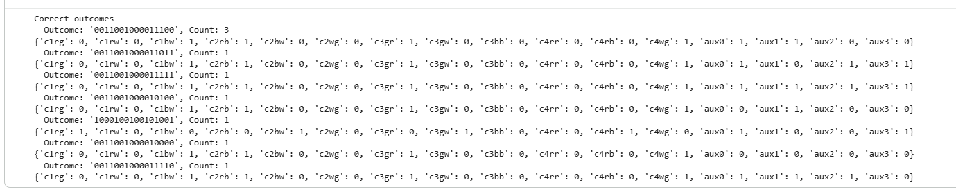
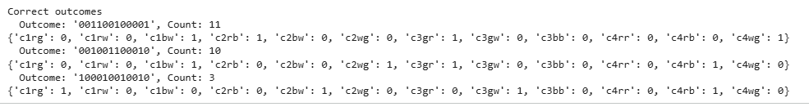
Benefit - Correct answers were little more probable now
Native COBYLA
COBYLA + Nelder-Mead
Both 10,000 shots

Slide 17
Our Conclusions
The “Quantum Advantage” with QAOA can be effectively utilised only if the classical minimization approach is chosen properly based on the problem.
To limit the search space even moreSome sources suggest that Mixer architecture can be tailored to the problem. (This is probably a good starting point to continue our work)
Weights and Penalties need to be tailored to the problem as well to lead the system in the correct direction.

Slide 18
References
https://www.math.ksu.edu/outreach/skday/2023/slides/FourCubesSlides.pdf
https://secquoia.github.io/QUBOBook/QUBO%20and%20Ising%20Models.html

Slide 19
BACKUP SLIDES

Slide 20
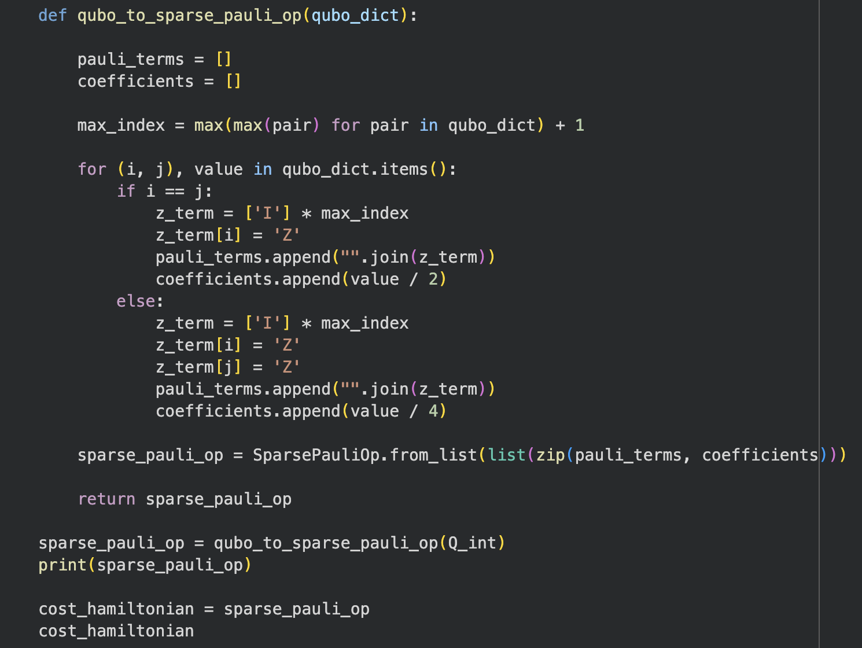
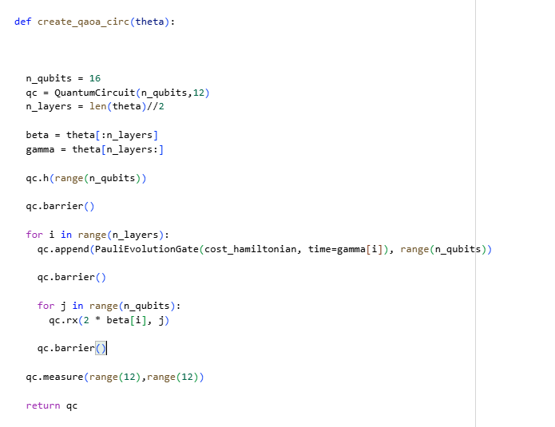
Solving Using Universal Quantum Computer

